Slide 1

Cricket FRONT Foot Overstep No-Ball Detection by using
IoT
GUIDED BY
DR.S.Prema MCA,M.Phil.,Ph.D..

Slide 2
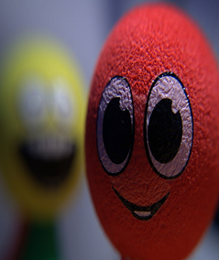
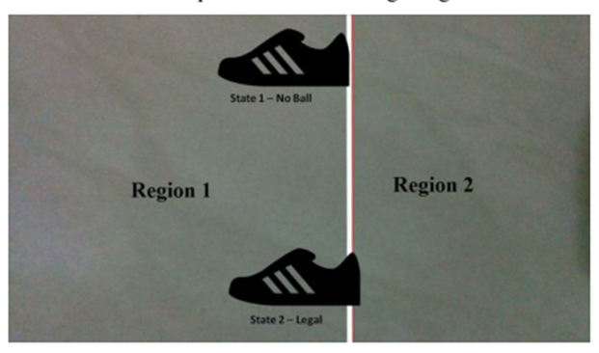
Do you know what is Mean By No-Ball ?
It Means a Illegal Delivery to the Batsman. It Awarded Extra Run to the Batting Team, For that Ball Batsman Receives Free Hit
Do you Know what is Mean by Front foot No-ball ?
The heel of the bowler's front foot lands on or in front of the popping crease (the front line of the batting crease).However, the front foot can be raised over the line as long as the heel does not go beyond the popping crease

Slide 3
ABSTRACT
Cricket is a worldwide popular game where different technologies are being used to help the match umpires to make decisions. Often due to the human perception, deciding whether a bowled delivery is a no-ball or legal ball which causes controversy.
The delivery is considered overstepped no ball if the heel of the front foot of bowler lands on or in front of the popping crease It was Difficult task for the umpires to detect the No ball
To make accurate decision. In this System sensor can Automatically detect the Overstepping Delivery and Sends the alert Message to the Umpire after that he Signals it as a No-Ball.

Slide 4
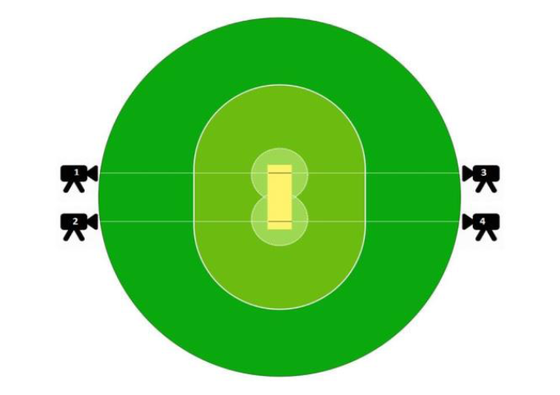
EXISTING SYSTEM
In Existing System image subtraction technique to analysis the video data to detect the overstep no ball. Our system model to detect the no ball
In that System 3rd Umpire can Check the Video footage of the previous ball to make Decision Whether it is a NO-BALL or Not
Image Subtraction Technique

Slide 5
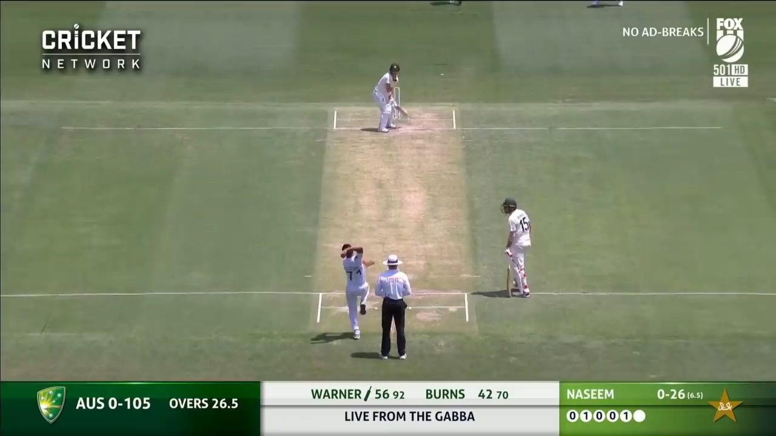
How Existing System Works
NO BALL ON INTERNATIONAL MATCH
Here On Field Umpire Un- Noticed the Front foot No Ball And Give Out for the Batsmen
After that 3rd Umpire Checks the Video Footage Of the Front foot Of the Bowler He noticed that it was a No Ball
So On field Umpire Change the Decision And Give No Ball Signal

Slide 6
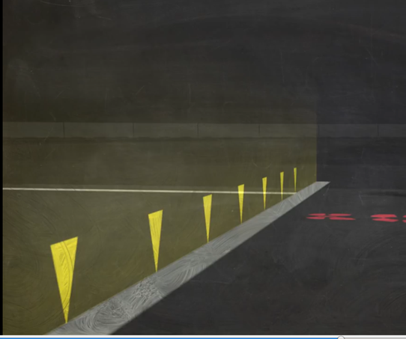
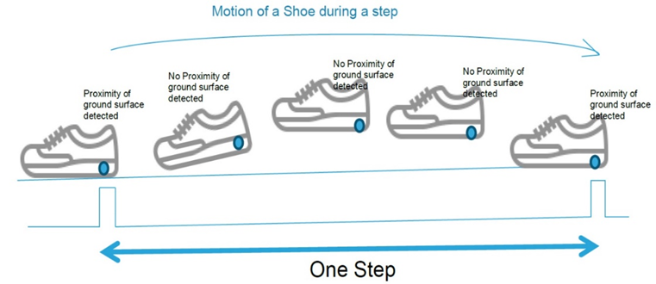
PROPOSED SYSTEM
In the proposed System we use the sensors in the cricket pitch
In the popping Crease we can use the Proximity sensor and Metal in bowlers shoe heal part
Proximity Sensor can able to detect the presence of nearby objects without any physical contact.
It can Detect the Overstepping Delivery and Sends the alert Message(Via Transmitter And Receiver) to the Umpire after that he Signals it as a No-Ball and Gives the Free hit And also in LCD Screen it Displays No- Ball Message
Proximity sensor in popping crease
Proximity sensor in customized shoe

Slide 7
HARDWARE REQUIREMENTS
Proximity Sensor (Inductive)
Arduino UNO
Bread board and jumper wires
Wi-Fi Module
Receiver and Transmitter
LCD Display
Customized Shoe (Metal in the shoe heal part)
Power supply (5v)
Software REQUIREMENTS
Arduino With Embedded C

Slide 8
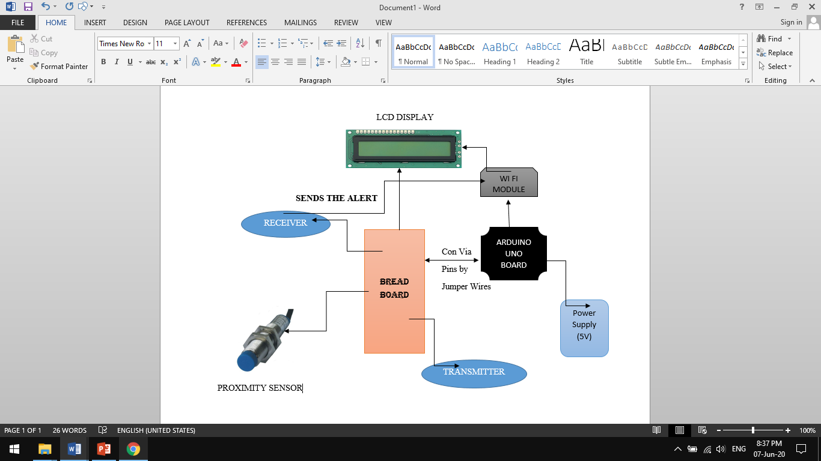
COMPONENTS CONNECTIVITY

Slide 9
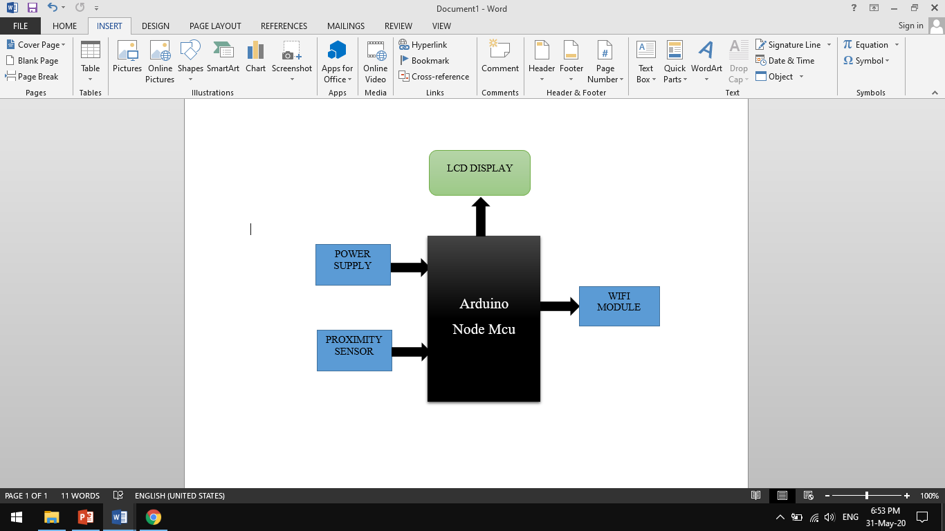
BLOCK DIAGRAM

Slide 10
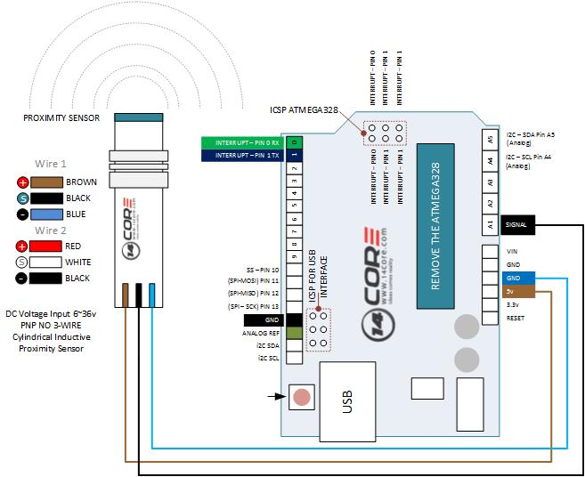
CIRCUIT CONNECTION

Slide 11
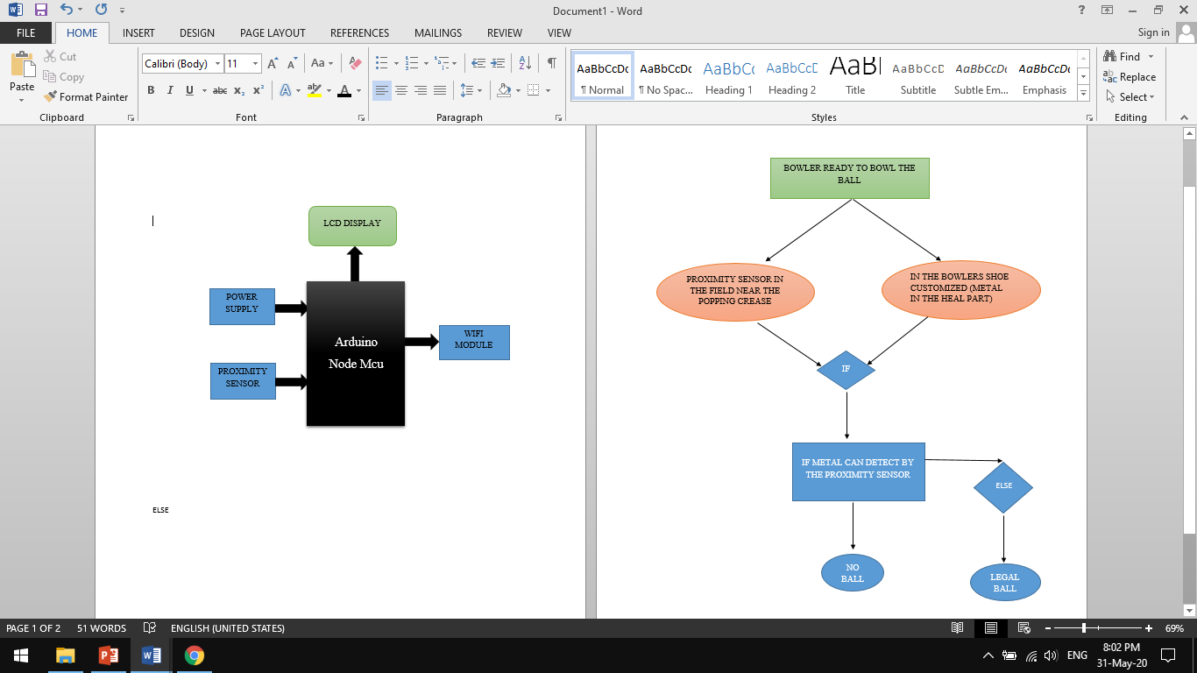
WORK FLOW

Slide 12
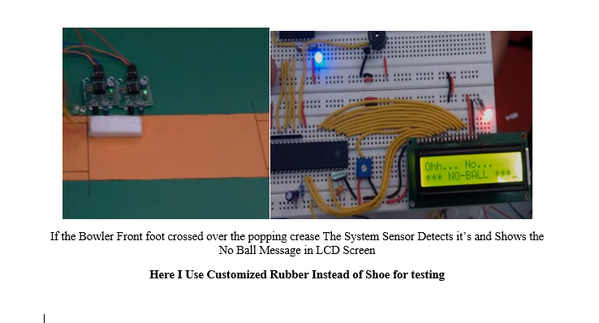
WORK IMPLEMENTATION

Slide 13
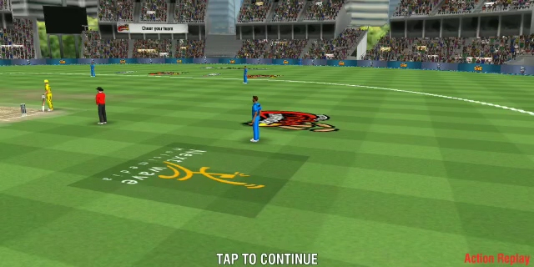
HOW IT WORKS

Slide 14
CONCLUSION
The sensors on the popping crease to detect the No Ball automatically. This will remove the interference of the On Field Umpire and the Third Umpire from the decision of the No Ball.
By solving this problem cricket will get 100% accuracy in No ball without any human factor involved in it.

Slide 15
FUTURE SCOPE
In future Replacement of Proximity Sensor we use Conductor in the Popping Crease and the bowlers shoe with the help of LED Light And 12v current passed in the Human body
If that system Detects the No Ball bowled by the Bowler LED Light in the popping Crease Gets blinking After that Umpire gives the No Ball signal

